Slide 1


Project 3 no wait 2 or maybe it's 3
Ash, Patty, Rosa, Tu Cam, Vik

Slide 2
Agenda
Using Akashfu this assignment was put together
Setting up MongoDB database
Connecting to Flask
Establishing website dashboard
Updated the database
Set up various visualizations
Not presenting the dashboard instead presenting a powerpoint
Had fun and ranted on

Slide 3
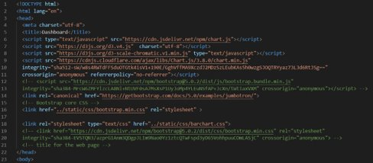
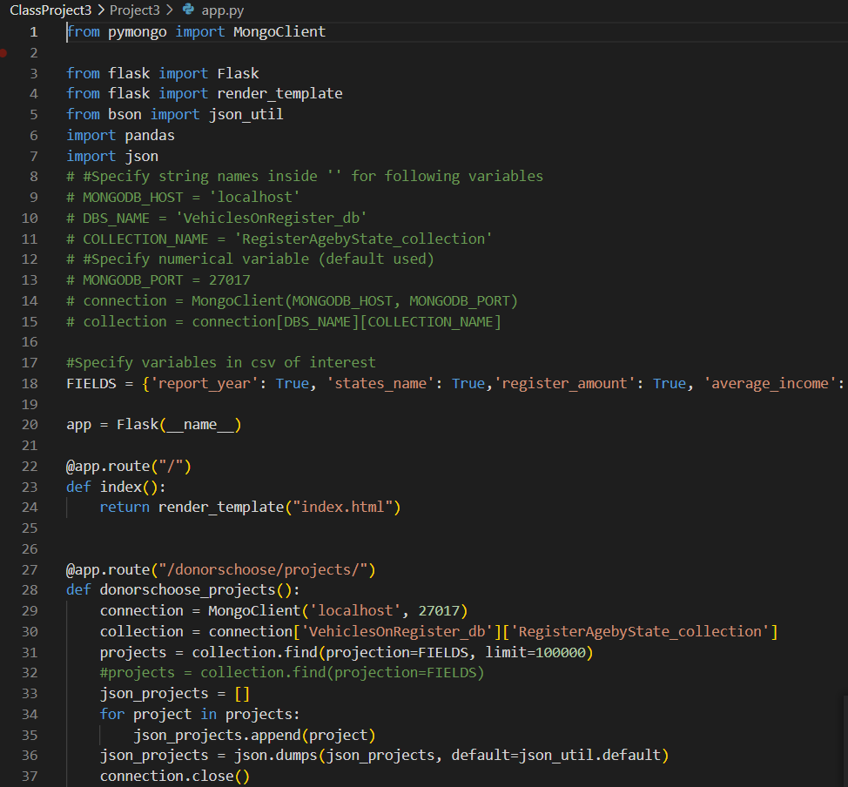
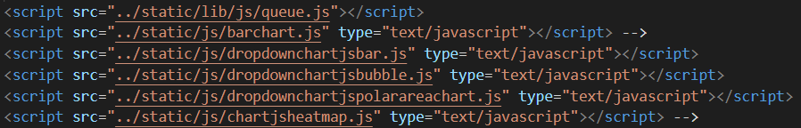
Html Setup + Flask Connection

Slide 4
Dashboard – bar chart

Slide 5
Dashboard – line chart

Slide 6
Dashboard – bubble chart

Slide 7
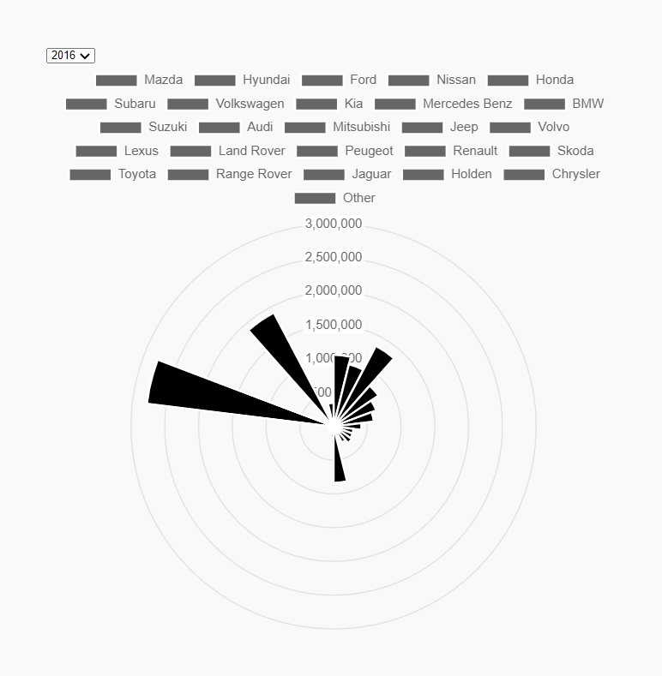
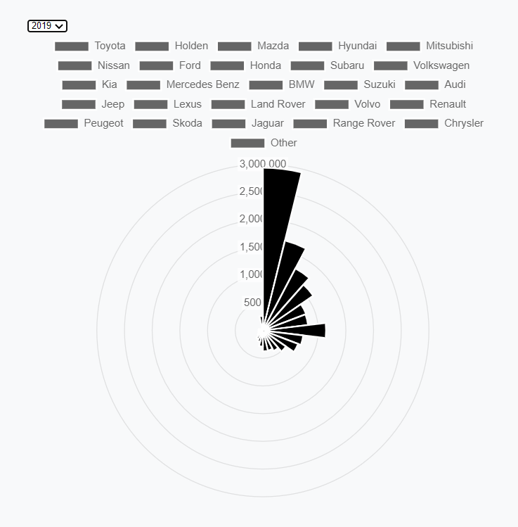
Dashboard – Polar chart
Setup separate API JSON from Flask Connection to Mongo db
Using Javascript setup the interactive polar chart to visually display the relationship between car brands and number of registrations
Using the toggle you can see this relationship evolve over time
Top 3 brands over 5 years include: Toyota, Mazda, Holden

Slide 8
Thanks for listening

